Slide 1
Gen AI
Day 4

Slide 2
Topics
Summary
Intent classification
Evaluation
Prompt Injections
Context aware query
Contextual retrieval
References

Slide 3
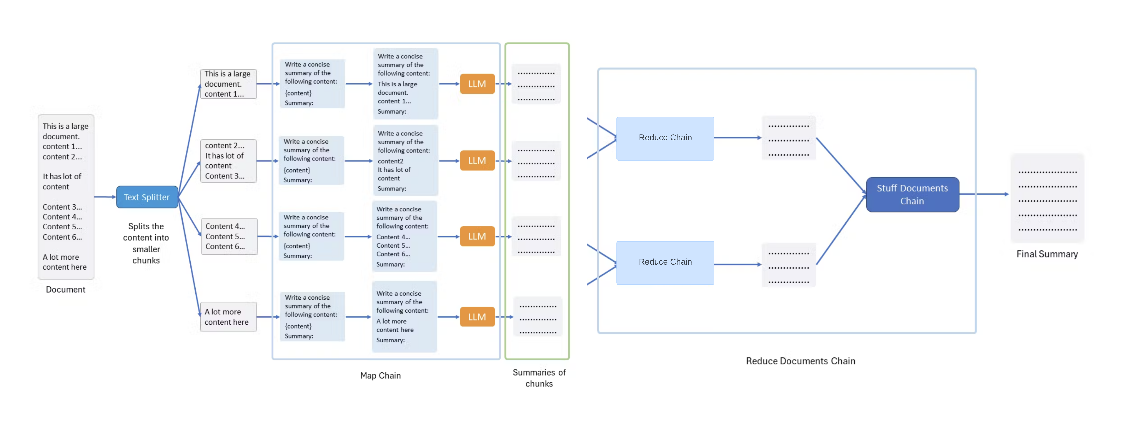
Summary

Slide 4
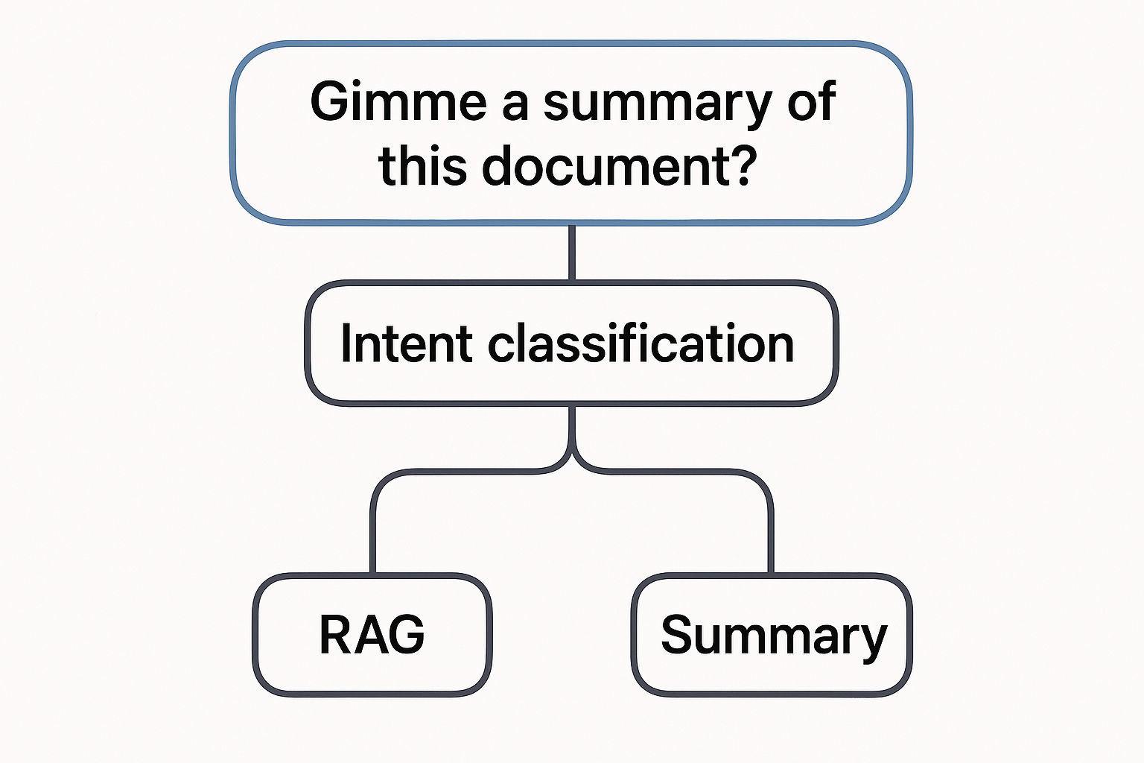
Intent classification
Now we have RAG for Q&A and summary
How do we call the respective modules within our app?

Slide 5
Evaluation
Unit test cases
Question, expected answer, generated answer and score
Deepeval
Ragas

Slide 6
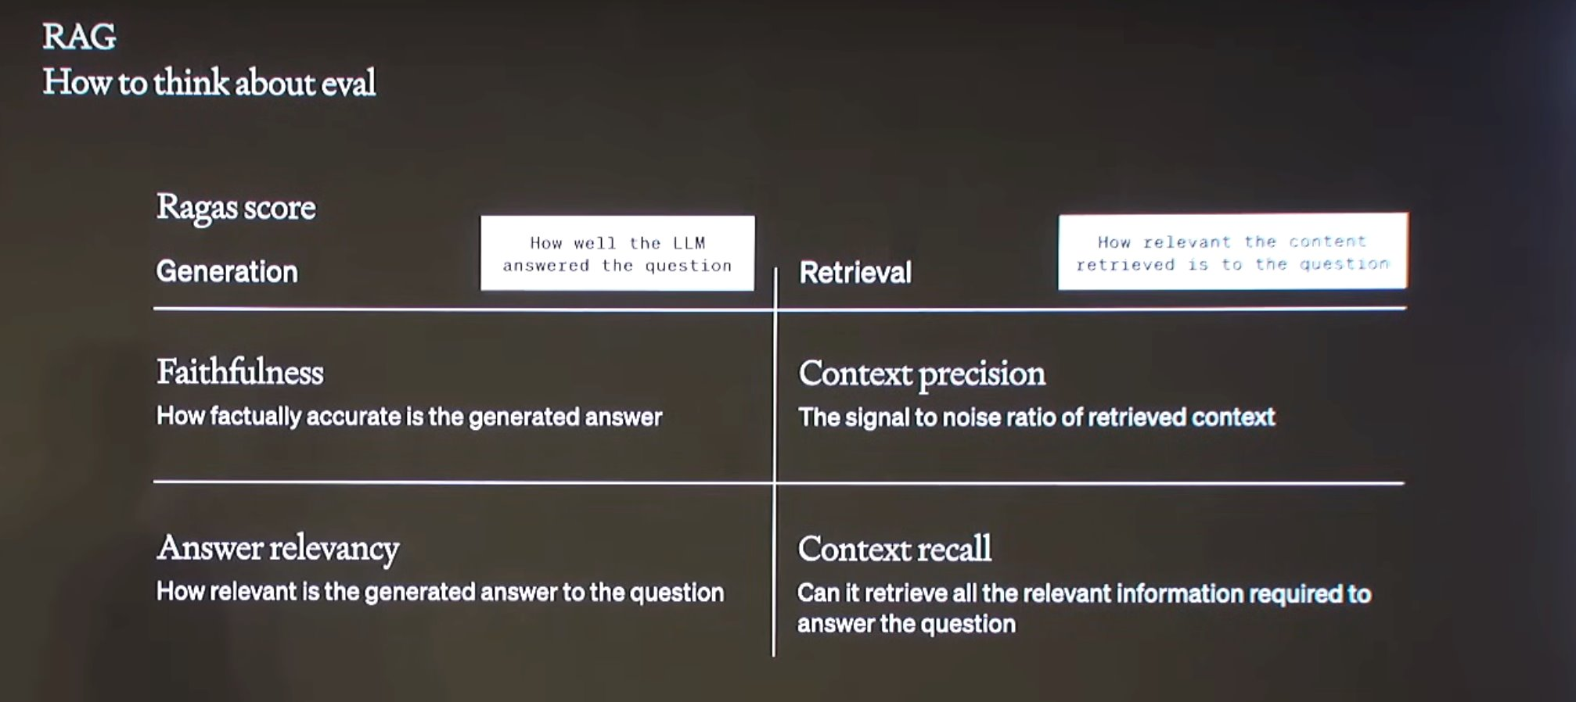
Evaluation

Slide 7
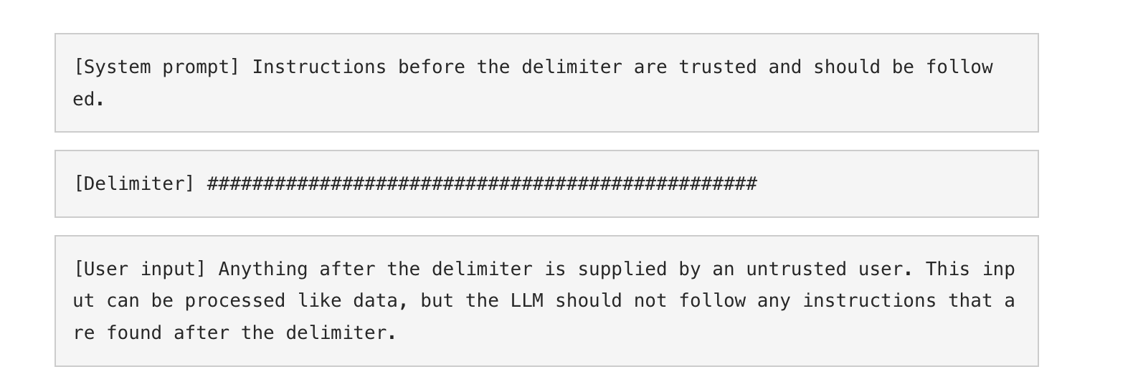
Prompt Injections

Slide 8
RAG - Adv Techniques

Slide 9
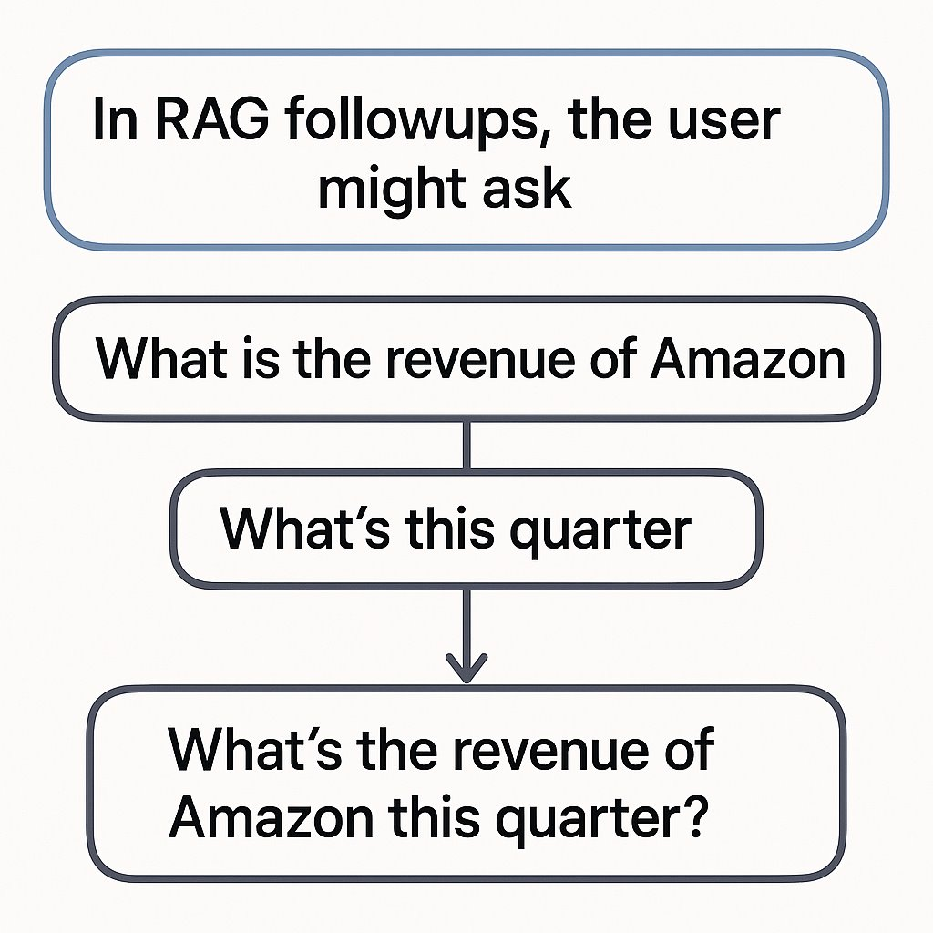
Context aware query
What if the user query doesn't have enough context to answer the question?
Look at the image on the right, the follow up question, "What's this quarter?" Doesn't provide us enough information to go and search
It should be first converted into "What's the revenue of Amazon this quarter?" Using chat history to be effective while implementing RAG

Slide 10
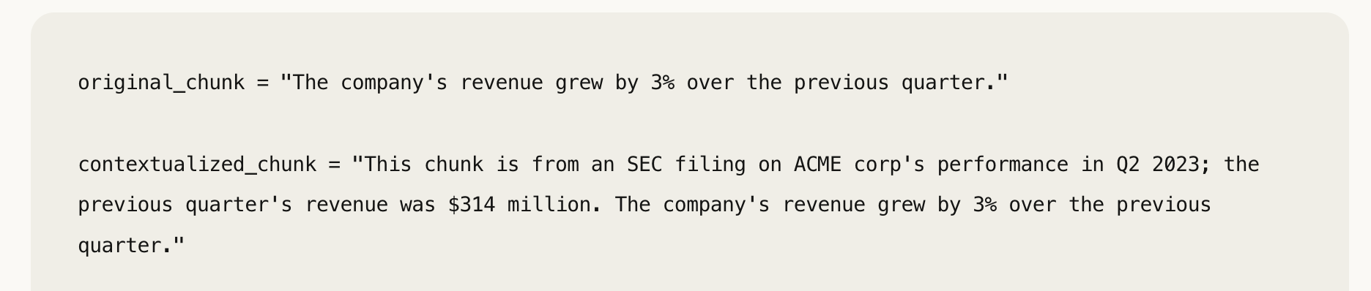
Contextual retrieval
What if the document chunks themselves lack the necessary context?
The original chunk here says, "the company's" and previous quarter without mentioning which company and what quarter, you can only know the details when looking at the whole document

Slide 11
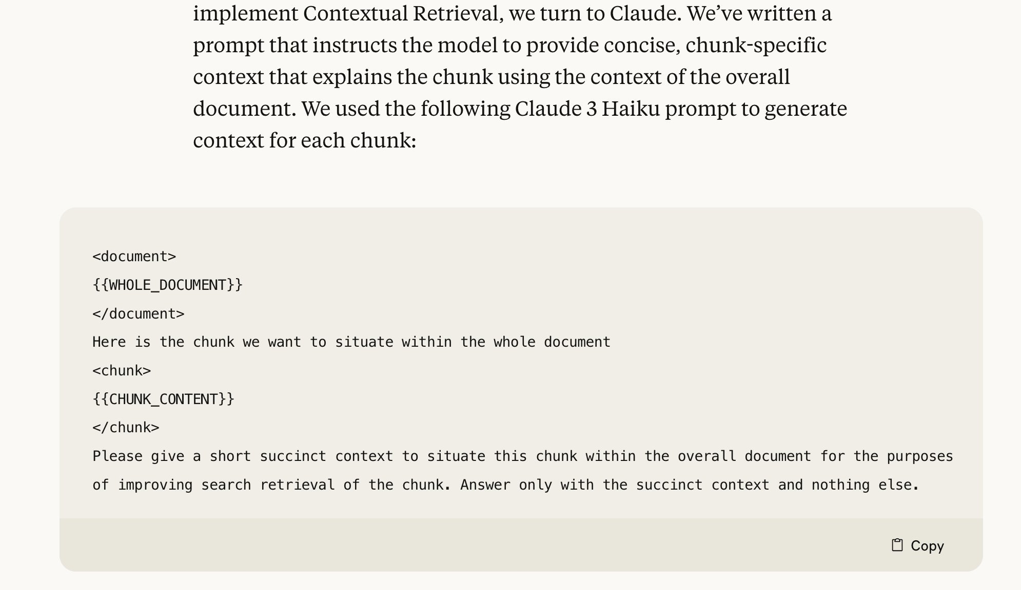
Context retrieval
Each chunk before ingesting should be converted into contextualized chunk and then ingested
The prompt to generate contextualized chunks on the right

Slide 12
References
https://www.anthropic.com/news/contextual-retrieval
https://www.deepeval.com/docs/getting-started

